Slide 1

311_DC
Group 8 (Hamour Group)

Slide 2
Table of contents
01
INTRODUCTION
02
Categries
03
Wrapping up the data
04
Result
- EXPLAIN THE DATA
Age categories
TOP Categries based on status
You can describe the topic of the section here

Slide 3
About the project
311 is a non-emergency number that residents in many cities
Call to find information about services or report an issue.
To improve time-to-close tickets.

Slide 4
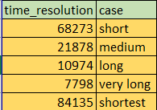
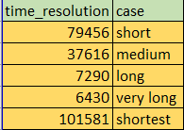
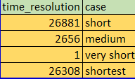
Age categories
2016
2018
2020
Short= 68273
Short= 79456
Short= 26881

Slide 5
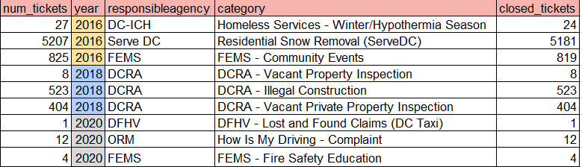
TOP Categries based on status
2016
2018
2020
Close= 288421
Close=322058
Close=82708

Slide 6
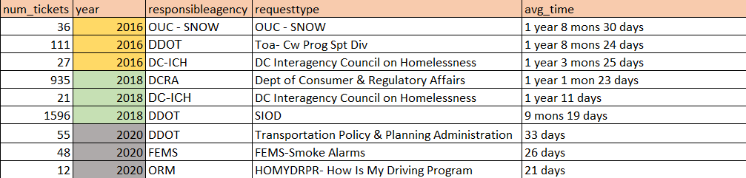
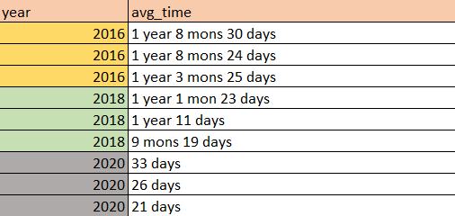
Categories that has the lowest ticket closing time
See 2016
Agencies with take long time closure VS
Agencies shortest closure times

Slide 7
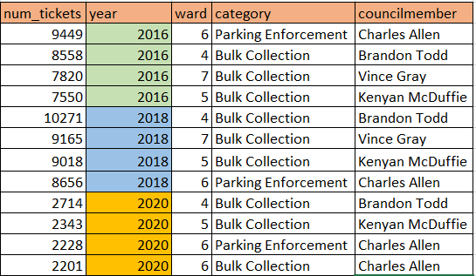
Tickets closed for each council member and ward

Slide 8
conclution
Found out based on the numbers of ticket comparing three different years:
Closing time is being lowered by: 1- first recommendation is to carry on the process going on. 2-educating the social about how to raise tickets properly. 3-focusing on high age tickets to lower the age tickets. 4-this will lead.

Slide 9
Thank You!

